Slide 1
Fetal Health Classification

Slide 2
List of Content
Overview
Business Problem
Data Understanding
Model
Evaluation and Results
Conclusion

Slide 3
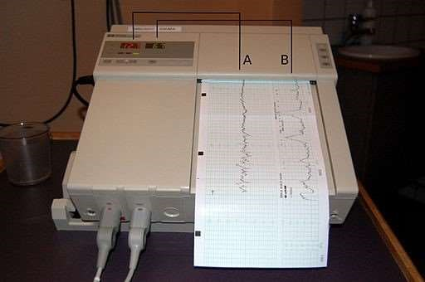

Slide 4
Overview
Fetal mortality is a major public health problem, with 1 million fetal deaths occurring annually in the US
Almost 26,000 fetal deaths occur after 20 weeks gestation
Fetal mortality is associated with increased risk of adverse maternal health outcomes and maternal mortality
Cardiotocograms (CTGs) measure fetal heart rate, movement, and uterine contractions
Automated CTG assessment has the potential to improve fetal and maternal outcomes by detecting potential health issues earlier.

Slide 5
Business Problem - Decreasing Fetal Mortality through Predictive Analysis of CTG Data
Fetal risk and mortality is a devastating problem
Predictive analysis of CTG data can help minimize the occurrence of fetal mortality
Medical practices can benefit from these findings by ensuring the best possible patient health
Prioritizing the global cause of decreasing fetal mortality can ultimately improve maternal and fetal health outcomes.

Slide 6
Data Understanding - CTG Exam Dataset and Fetal Health Classification
The dataset used in this project contains 2,126 rows of 22 features extracted from CTG exams
The dataset was classified by expert obstetricians into 3 classes:
Normal
Suspect
Pathological
The 3-class classification of fetal health outcomes in the dataset provides a valuable basis for predicting fetal health based on CTG data.

Slide 7
Data Understanding
light_decelerations
baseline value
accelerations
fetal_movement
uterine_contractions
severe_decelerations
abnormal_short_term_variability
mean_value_of_short_term_variability
percentage_of_time_with_abnormal_long_term_variability
prolongued_decelerations
mean_value_of_long_term_variability
histogram_width
histogram_min
histogram_max
histogram_number_of_peaks
histogram_number_of_zeroes
histogram_mode
histogram_mean
histogram_median
histogram_variance
histogram_tendency
fetal_health
Target Variable

Slide 8
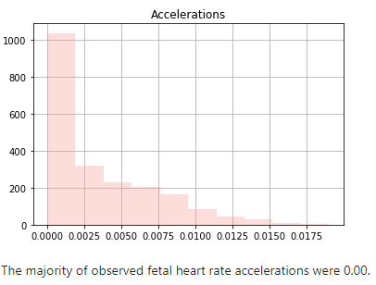
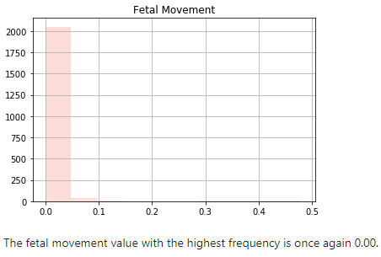
Data Understanding - CTG Exam Dataset and Fetal Health Classification

Slide 9
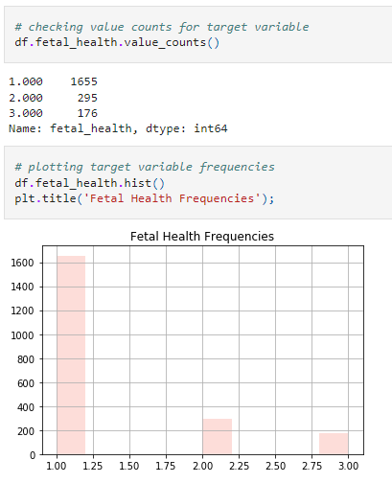
Data Preparation
Target class is unbalanced with majority being Normal fetal health (1.00)
Second-highest frequency is Suspect fetal health (2.00)
Pathological fetal health (3.00) has the lowest frequency in the dataset

Slide 10
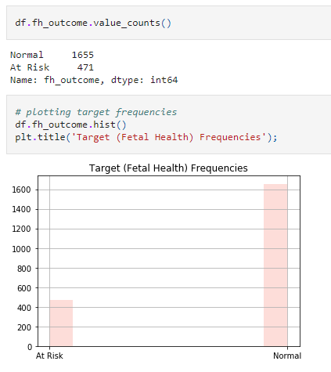
Data Preparation
Dataset converted from multi-class classification to binary classification problem
Combined Suspect and Pathological classes to create a new At Risk class
Normal class has the highest frequency while At Risk class has the lowest frequency

Slide 11
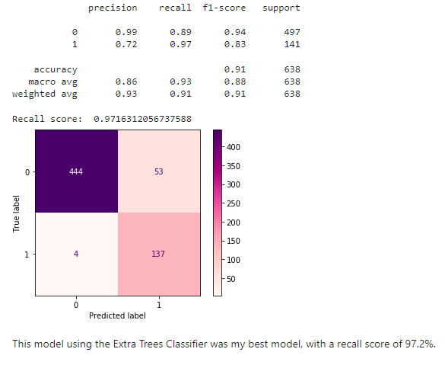
Modeling
Extra Trees w/ Pipeline and Grid Search

Slide 12
Evaluation and Results
Priority metric: Recall/Sensitivity to capture all instances of the positive class and avoid false negatives or Type II errors.
Best model: Extra Trees Classifier.
Achieved Recall score: 97%, meaning that 97% of the at-risk class was captured by the model.
Achieved Accuracy score: 91%, meaning that 91% of the total predictions made by the model were correct.
Trade-off between recall and precision affects accuracy, but the priority is given to human life, so recall is prioritized at the expense of other metrics.

Slide 13
Evaluation and Results
The F1 score of the model is 83%, indicating good overall performance
The AUC of the model is 94.5%, confirming that the model is working well

Slide 14
Conclusion
Cardiotocogram (CTG) data provides insight into fetal health outcomes.
ML models can predict fetal distress using CTG data with high recall/sensitivity.
Expert knowledge of obstetricians can be combined with ML models to prioritize fetal and maternal health.
Prioritizing fetal and maternal health can effectively reduce yearly fetal mortality rates.

Slide 15
References
Fetal-health-classification/fetal_health_classification.ipynb at main ·
dtunnicliffe/fetal-health-classification. (2021,February 9). GitHub.
https://github.com/dtunnicliffe/fetal-health-classification/blob/main/fetal_health_classification.ipynb
Fetal health classification. (n.d.). Kaggle: Your Machine Learning and Data Science Community.
https://www.kaggle.com/datasets/andrewmvd/fetal-health-classification

